Slide 1



Deep Neural Network On FPGA PDR
Students:
Amit Shtober
Alon Nemirovsky
Supervisors:
Ina Rivkin
Oz Shmueli
Winter 2020-2021

Slide 2
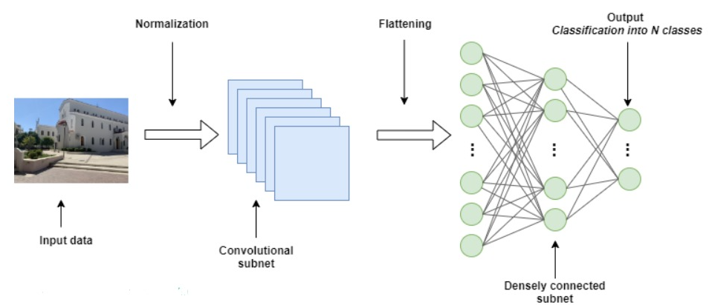
Deep Neural Network
Creation of Neural Network was inspired by the human brain and the way it functions
Works according to the algorithm and can predict a solution based on experience
The system has process layers that indicates on the depth of the Neural Network
This method is very popular and highly used today

Slide 3
Creating The Network
Full process of creating working neural network Includes:
Creating the model
Train it using CPU/GPU
Optimize the model
Goal is to reduce model complexity with minimal accuracy impact and maintain low latency with high throughput
For example: converting the 32-bit floating-point weights to fixed-point or minimize the number of layers in the model
Inference which can be done on various machines such as host using GPU or dedicated Hardware
Create and manufacture the dedicated hardware which will run the Inference stage

Slide 4
The Problems
Creating dedicated hardware is hard
The process of creating a fully working chip could take years
Expensive process
Model optimization is difficult
Complex to reach a significant improvement
Long and slow process

Slide 5
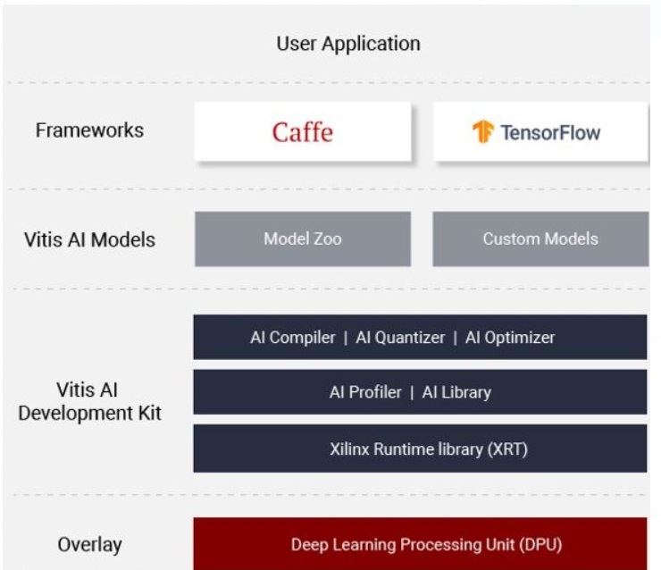
Vitis-AI Ecosystem
Xilinx offers a full ecosystem which helps deal with those problems. It includes:
Dedicated IP which called DPU
AI Zoo - Repository which includes optimized deep learning models. Great for quick start with pre-trained models.
Quantizer - Takes a floating-point model and performs pre-processing and then quantizes the weights/biases and activations to the given bit width
Compiler - Maps a network model into a highly optimized DPU instruction sequence
Optimizer – Prunes redundant connections in neural
networks and reduces the overall
required operations
Profiler - Application level tool that can help to
optimize the whole AI application by detecting
the bottleneck of the whole AI application

Slide 6
ZCU104 evaluation board
An integrated circuit designed to be configured by a designer using HDL
Great for parallel tasks (adders and multipliers)
USB
PL - FPGA
PS - ARM® Cortex™-A53 processor
UART
ETHERNET
SD CARD
ZCU104
evaluation
board
DDR4

Slide 7
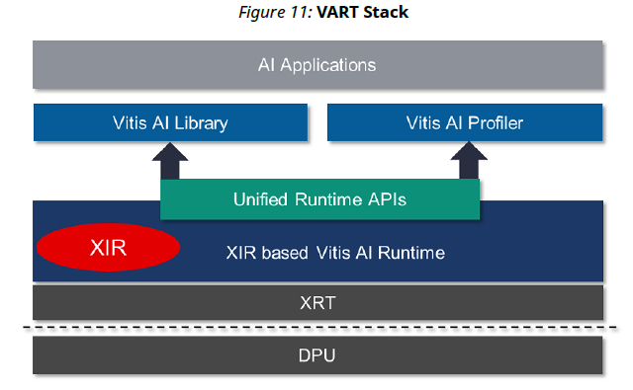
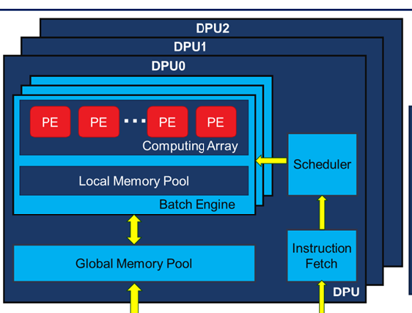
DPU IP
Dedicated IP which called DPU. It’s a programmable engine dedicated for convolutional neural network. There is a specialized instruction set for DPU, which enables DPU to work efficiently for many convolutional neural networks
Along side the DPU IP we also receive VART - Vitis AI unified high-level C++/Python API that let us run instructions on the DPU

Slide 8
Full Process - Block Diagram
Fetch trained
Model
Xilinx Zoo
V-AI Quantizer
Trained Model
Quantized Model
V-AI Compiler
Train using
Tensorflow
Host code
VART based code, send instructions to the DPU
Transfer to the Host Code
Kernel code
Compiled Model DPU instruction set
Untrained Model
ZCU104 evaluation board
ARM run the host code
Instructions
DPUS run the DPU instructions
DPU Verilog Xilinx IP
Results
The DPU IP Uploaded as a bitfile to the FPGA during board booting, using the SD CARD slot

Slide 9
Project Goals
Evaluate and validate the Xilinx Vitis-AI ecosystem :
1. Understanding Vitis-AI ecosystem
2. Running full flow of resnet50 model from Tensor Flow to the FPGA
Step #1 – Using trained model from Xilinx Zoo
Step #2 – Using untrained model from the zoo, Modify it and run the flow in order to fully understand the ecosystem ability
3. Evaluate and modify, when possible, each step in the process of the ecosystem
4. Creating a tutorial for running the flows step by step and indicate problems we have encountered in the process

Slide 10
Schedule
Duration | Start Date | Task
Week | 21.10.20 | Reach basic understanding the product and its capabilities
Two and half weeks | 28.10.20 | Creating a Working environment for the tools
Two weeks | 15.11.20 | Running full procedure on the model resnet50 from Xilinx Zoo to the Board
3-4 weeks | 7.12.20 | Running full procedure on the model resnet50 from Tensorflow Zoo to the Board

